Slide 1




玩转IEEE数据库，让你的科研操作溜起来~
欢迎关注“IEEE Xplore 微服务”
iGroup China
IEEE数据库培训师
马向伟

Slide 2




01 /
初识 IEEE
Contents
02 /
抽丝剥茧
（深度挖掘单篇文章的潜在资源）
03 /
顺藤摸瓜
（由潜在资源检索更多内容）
START>>>
04 /
有的放矢
（IEEE期刊会议投稿）
05 /
IEEE 相关资源推介

Slide 3
初识 IEEE

Slide 4

the Institute of Electrical and Electronics Engineers
电气电子工程师学会
IEEE, pronounced "Eye-triple-E"

Slide 5
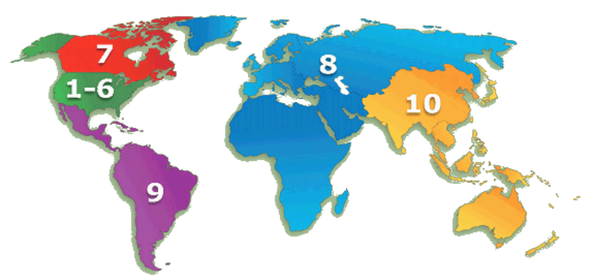
About IEEE
the world’s largest technical professional organization（全球最大的技术行业学会）
More than 422,000 members in more than 160 countries（会员）
More than 123,000 Student members（学生会员）

Slide 6
39 technical Societies
IEEE Aerospace and Electronic Systems Society
IEEE Antennas and Propagation Society
IEEE Broadcast Technology Society
IEEE Circuits and Systems Society
IEEE Communications Society
IEEE Computational Intelligence Society
IEEE Computer Society
IEEE Consumer Electronics Society
IEEE Control Systems Society
IEEE Dielectrics and Electrical Insulation Society
IEEE Education Society
IEEE Electron Devices Society
IEEE Electronics Packaging Society
IEEE Electromagnetic Compatibility Society
IEEE Engineering in Medicine and Biology Society
IEEE Geoscience and Remote Sensing Society
IEEE Industrial Electronics Society
IEEE Industry Applications Society
IEEE Information Theory Society
IEEE Instrumentation and Measurement Society
IEEE Intelligent Transportation Systems Society
IEEE Magnetics Society
IEEE Microwave Theory and Techniques Society
IEEE Nuclear and Plasma Sciences Society
IEEE Oceanic Engineering Society
IEEE Photonics Society
IEEE Power Electronics Society
IEEE Power & Energy Society
IEEE Product Safety Engineering Society
IEEE Professional Communication Society
IEEE Reliability Society
IEEE Robotics and Automation Society
IEEE Signal Processing Society
IEEE Society on Social Implications of Technology
IEEE Solid-State Circuits Society
IEEE Systems, Man, and Cybernetics Society
IEEE Technology and Engineering Management Society
IEEE Ultrasonics, Ferroelectrics, and Frequency Control Society
IEEE Vehicular Technology Society
Notes:
IEEE Components, Packaging, and Manufacturing Technology Society
（IEEE CPMT Society） has changed its name to the IEEE Electronics Packaging Society.

Slide 7

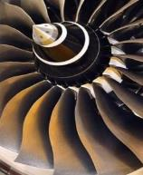
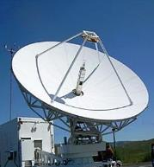


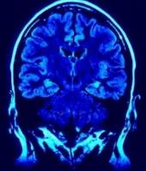

IEEE publications in key technology areas， more than just electrical engineering & computer science
• Information Technology
• Medical Devices
• Nanotechnology
• Optics
• Petroleum & Gas
• Power Electronics
• Power Systems
• Robotics & Automation
• Semiconductors
• Smart Grid
• Wireless Broadband
and more
• Aerospace & Defense
• Automotive Engineering
• Biomedical Engineering
• Biometrics
• Circuits & Systems
• Cloud Computing
• Communications
• Computer Software
• Electronics
• Energy
• Engineering
• Imaging
出版世界电气电子工程和计算机领域
的文献

Slide 8
IEEE Xplore 全文数据库
190+ IEEE期刊和杂志
1700+ IEEE会议录（每年）
8000+ IEEE标准文档
30+ IET期刊和杂志
20+ IET会议录（每年）
VDE会议录
Bell Labs技术期刊
IBM期刊，MIT期刊, AGU期刊, URSI
(OA 期刊): TUP, CSEE, CPSS, CES, CMP，BIAI，SAIEE
电子书：
IEEE-Wiley, Wiley Telecom，MIT电子书
Morgan & Claypool，Now Publishers综述文集
SMPTE期刊、会议、标准
在线课程
190+ IEEE期刊和杂志
1700+ IEEE会议录（每年）
3900+ IEEE标准文档（草案除外）
30+ IET期刊和杂志
20+ IET会议录（每年）
VDE会议录
Bell Labs技术期刊
IEEE/IET Electronic Library (IEL) 数据库
Notes:
IET:英国工程技术学会
VDE：德国电气工程师学会
AGU：美国地球物理学会
TUP：清华大学学报英文版
CSEE 中国电机工程学会
BIAI：北京航天情报与信息研究所 期刊
New OA Journals:
China Power Supply Society (CPSS)中国电源学会
Transactions on Power Electronics and Applications
China Electrotechnical Society (CES)中国电工技术学会
Transactions on Electrical Machines and Systems (CES-TEMS)
China Machine Press (CMP)机械工业出版社
Chinese Journal of Electrical Engineering (CJEE
URSI Radio Science Bulletin<法>国际无线电科学联合会
IEEE-Wiley：IEEE和Wiley合作出版的电子书近800本，横跨众多技术领域，包括生物工程、电力能源、通信技术等多方面研究
MIT：计算机科学和工程技术方面电子书600多本
Morgan & Claypool：综述文集700多本，重点聚焦工程和计算机科学
SMPTE 美国电影电视工程师学会 期刊、会议、标准

Slide 9
抽丝剥茧
（深度挖掘单篇文章的潜在资源）

Slide 10

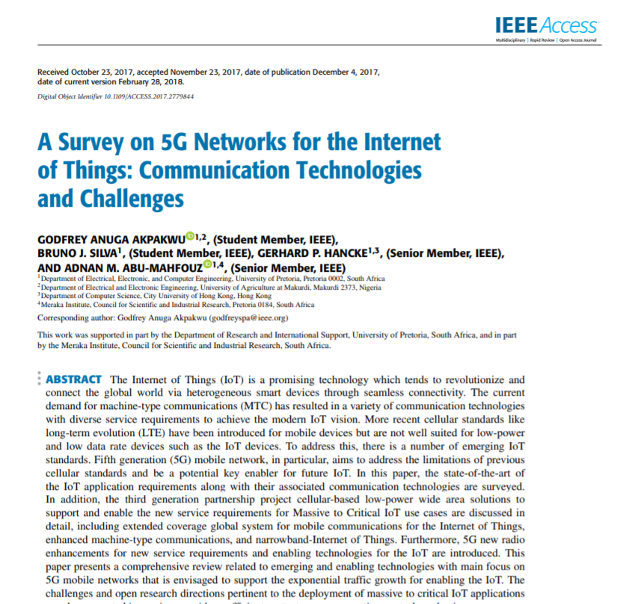

别拿着盾牌当令箭了，
保卫地球我们需要高科技。
这篇文章的技术点我们可以研究下
哎哟，老铁，可以啊，
5G和物联网
紧跟科技热点啊！

Slide 11

IP控制
URL: https://ieeexplore.ieee.org

Slide 12
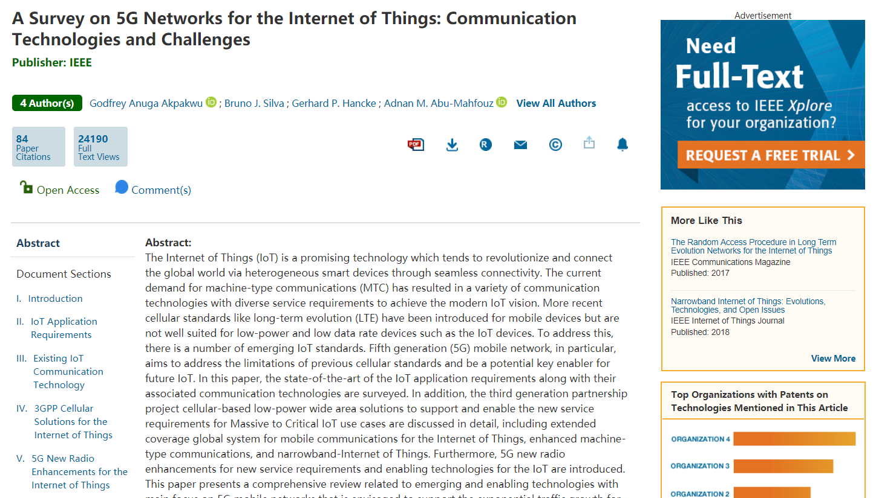
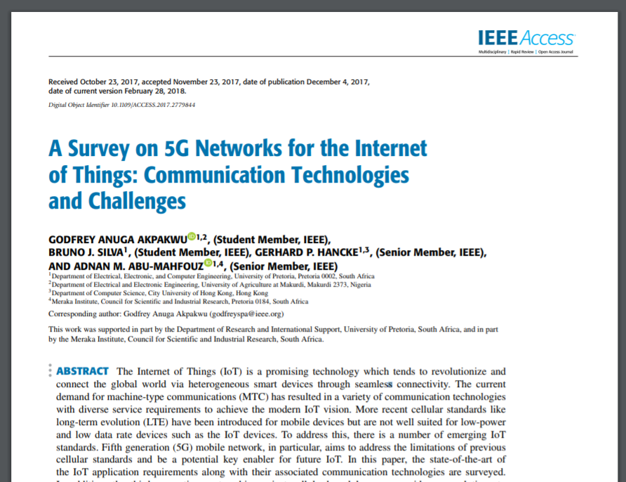
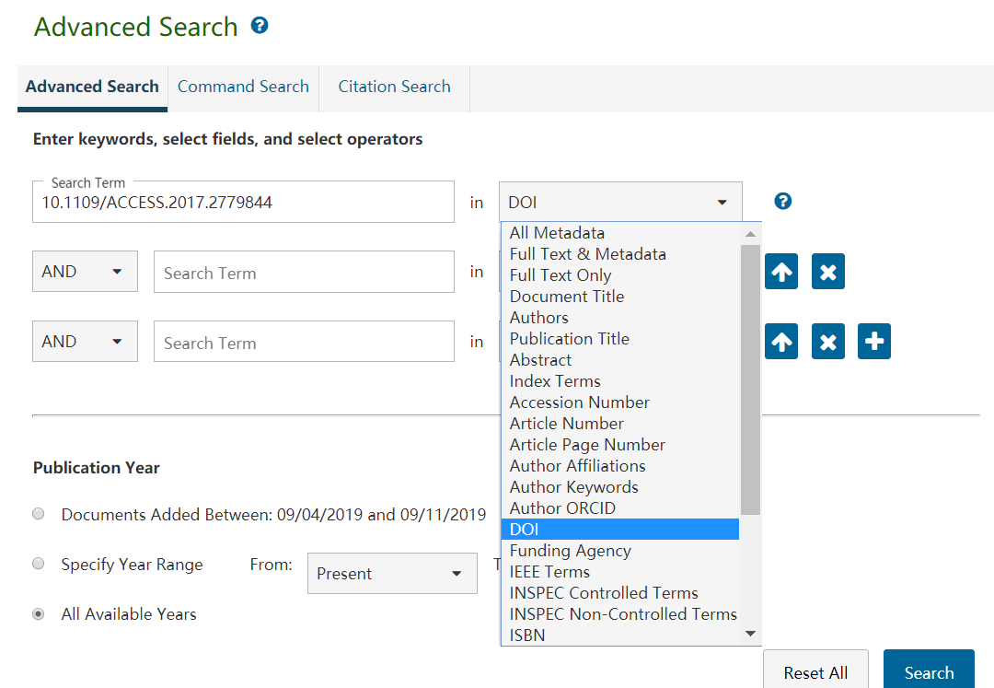
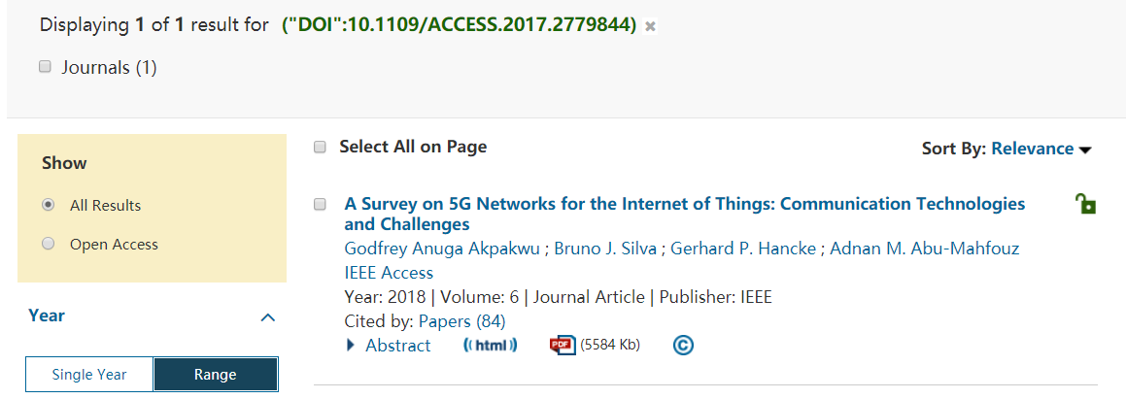
不允许电脑程式或某些非法下载软件

Slide 13
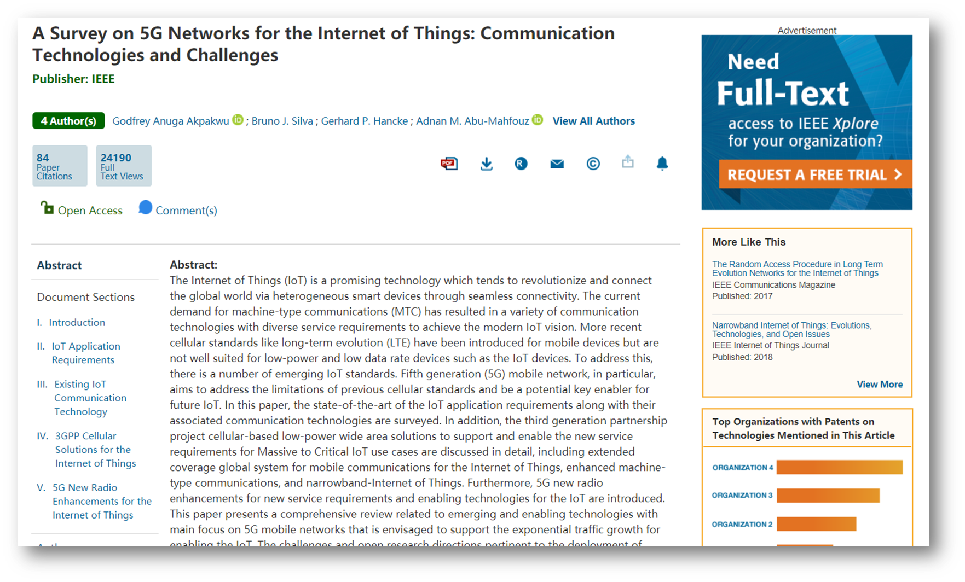
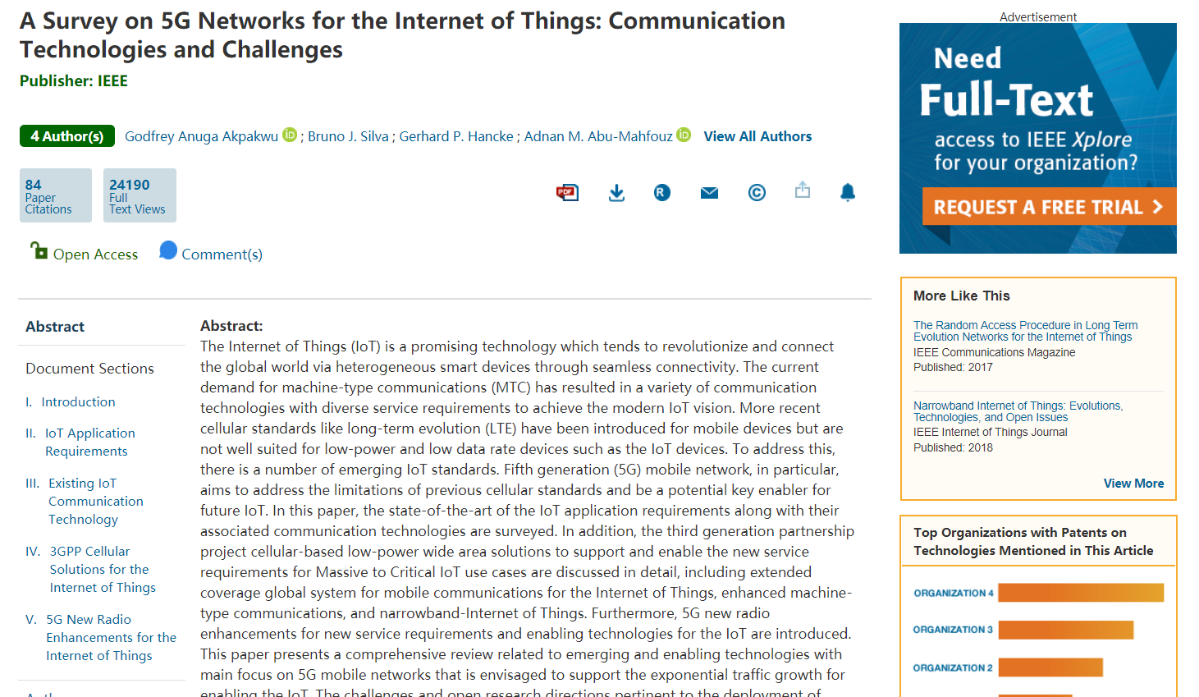
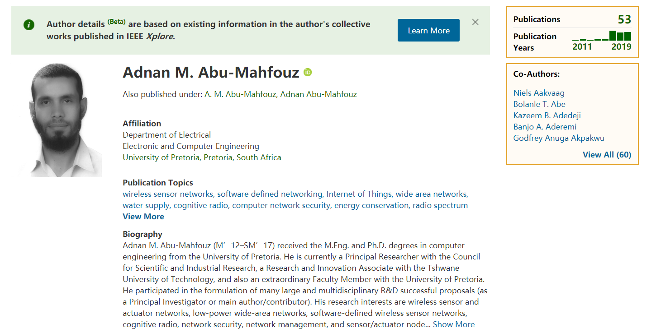
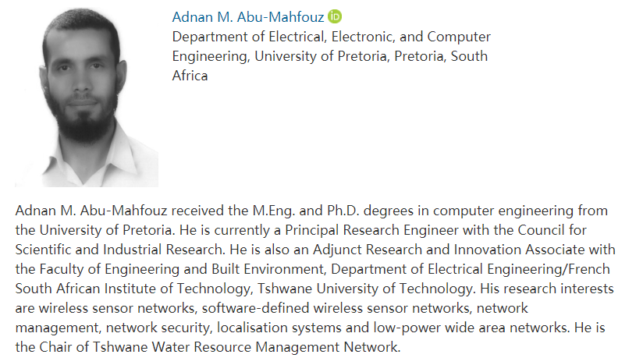
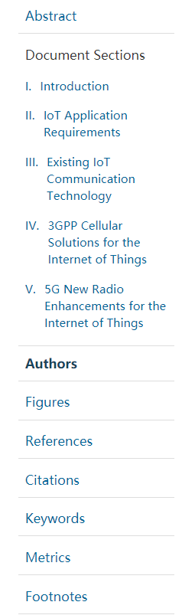
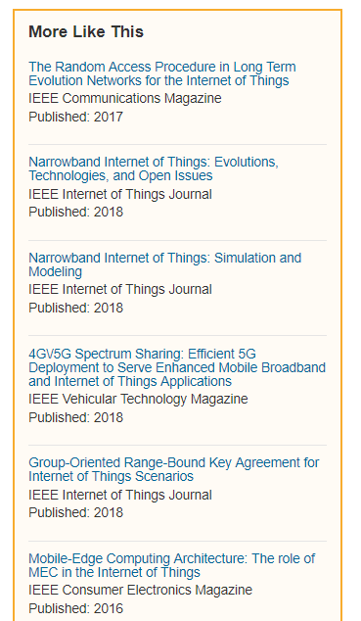
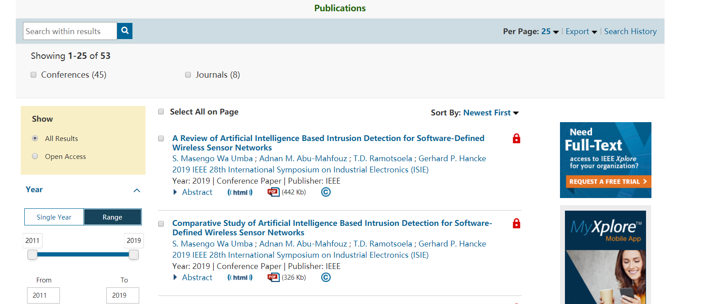
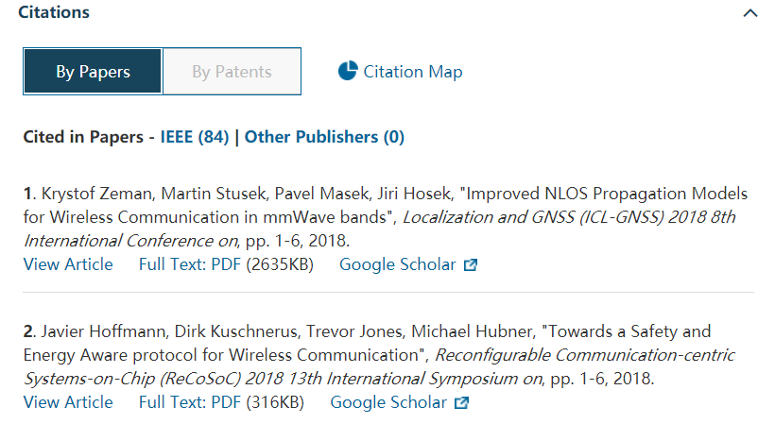
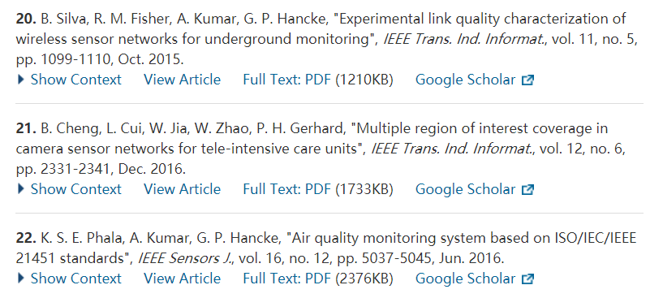

Slide 14
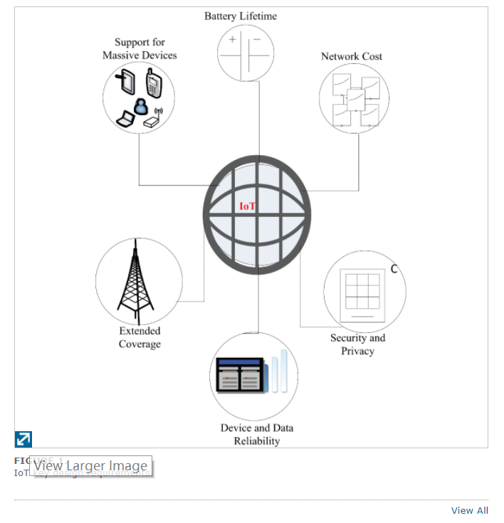
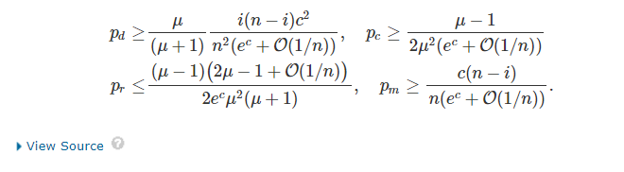
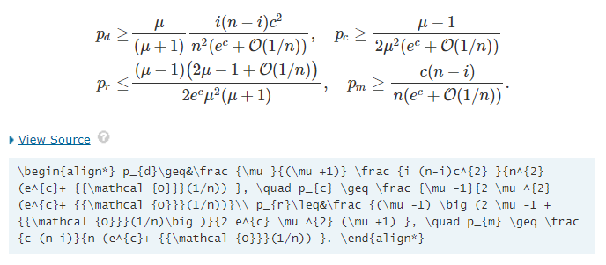
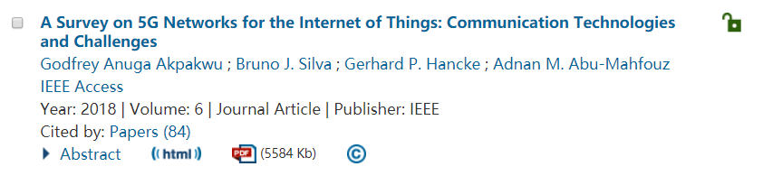
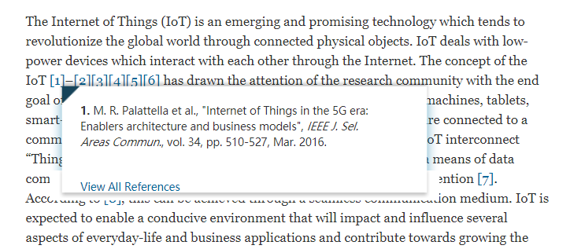

Slide 15
顺藤摸瓜
（由潜在资源检索更多内容）

Slide 16

检索方式——Global Search（一框式检索）

Slide 17
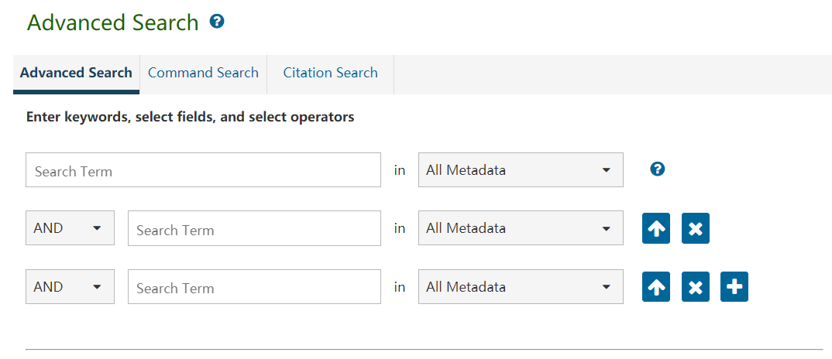

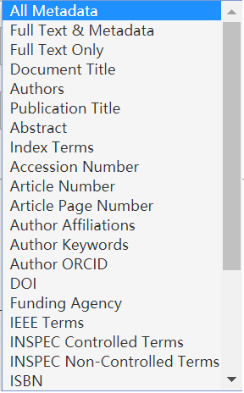
检索方式——Advanced Search（高级检索）

Slide 18
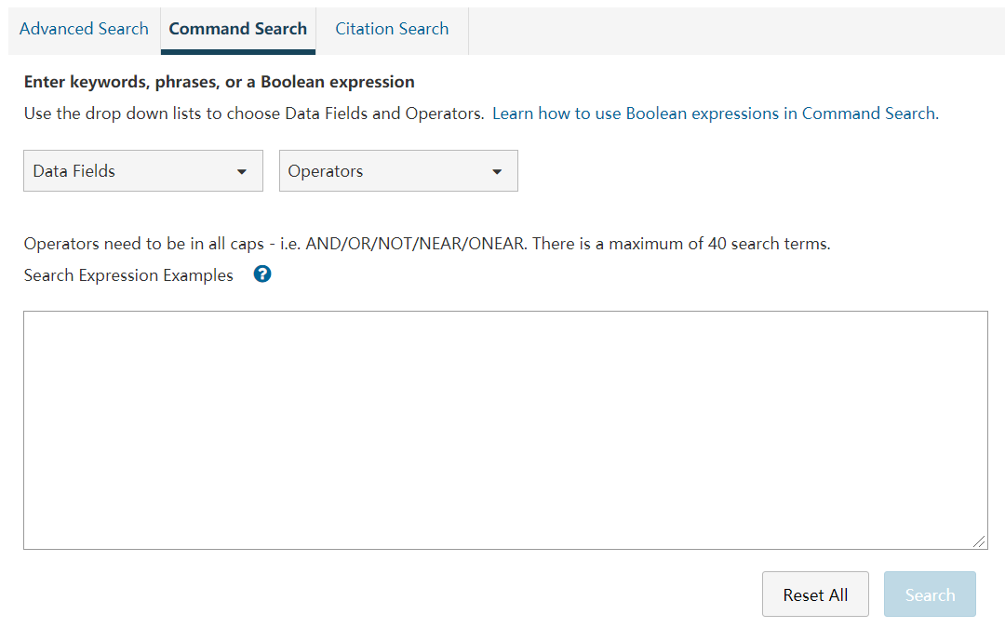
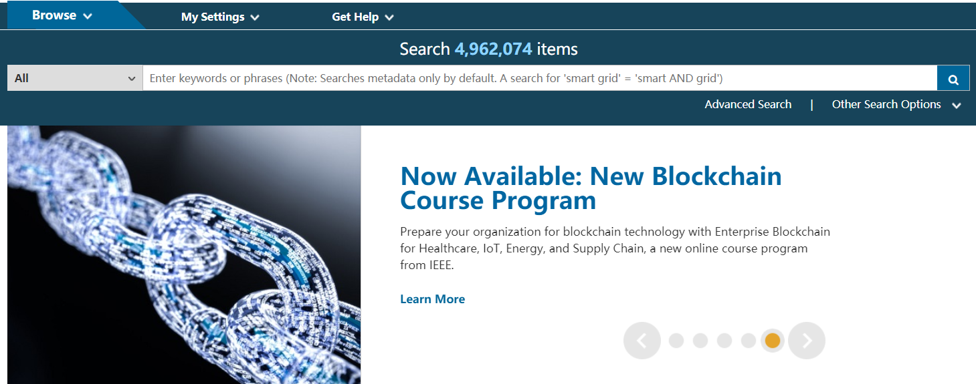
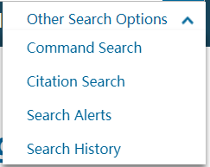
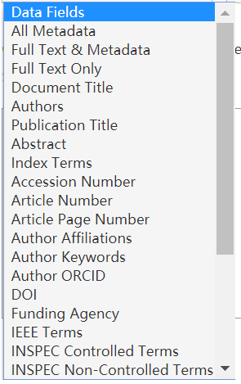
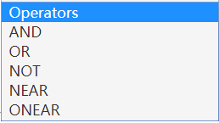
检索方式——Command Search（命令检索）

Slide 19
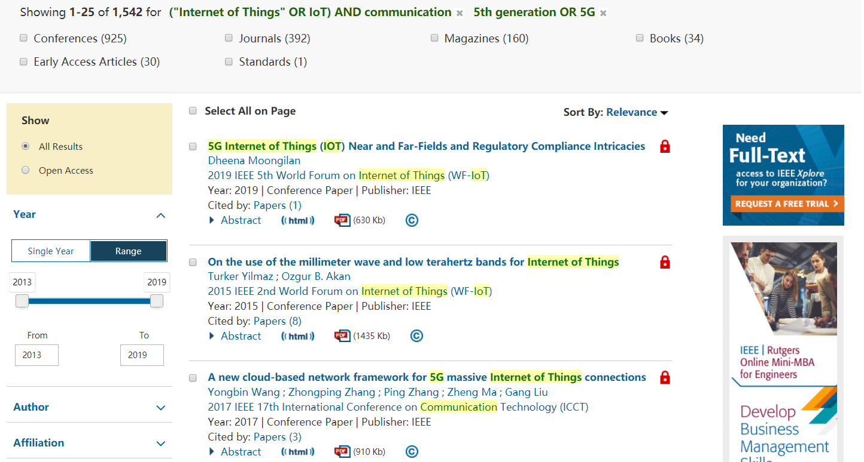
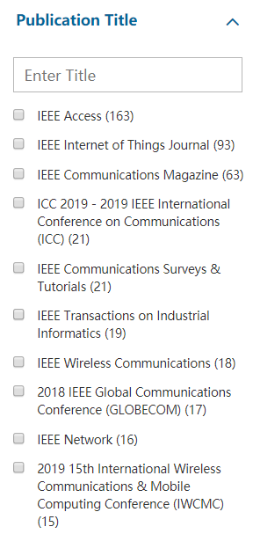
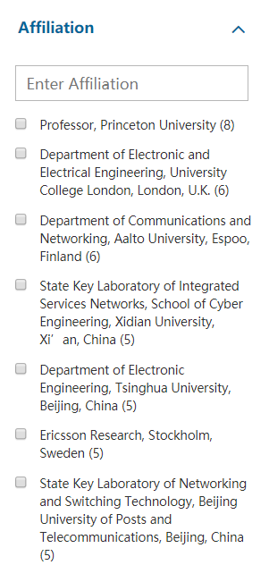
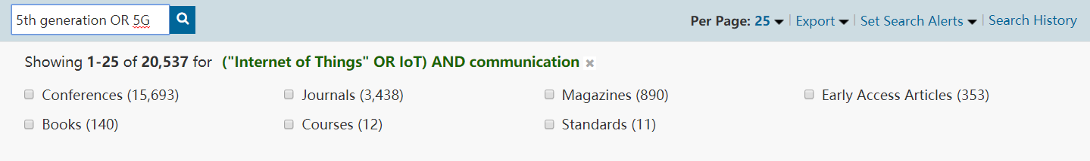
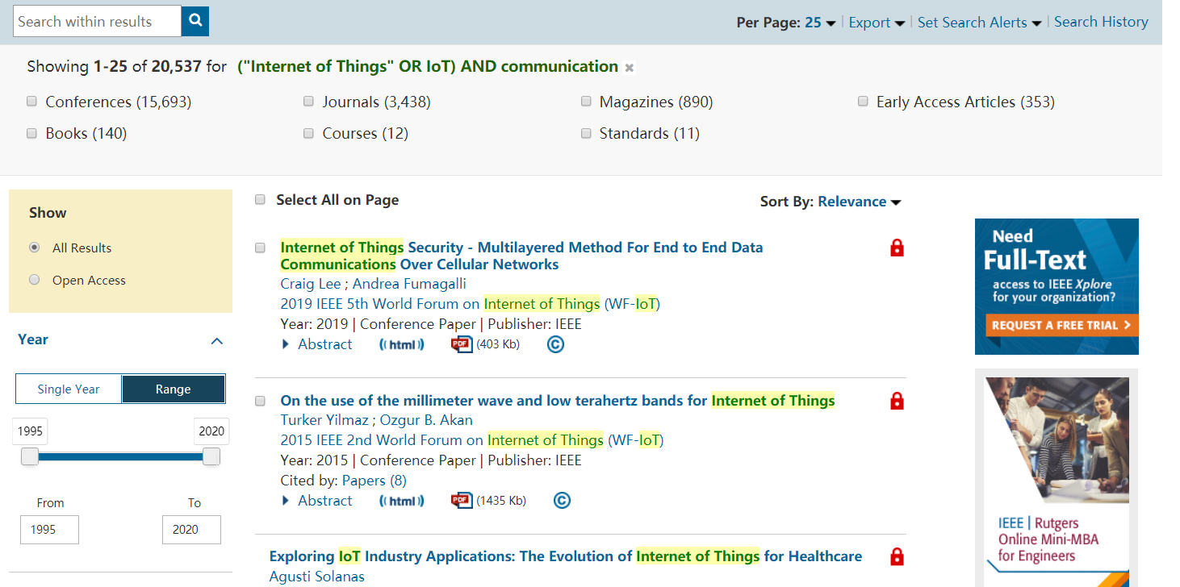
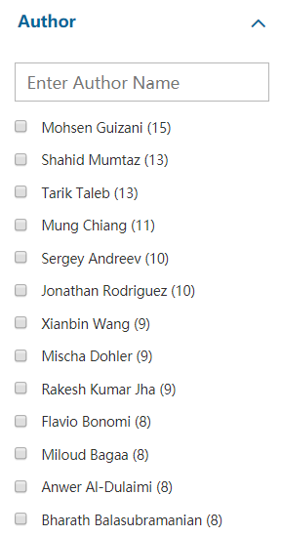
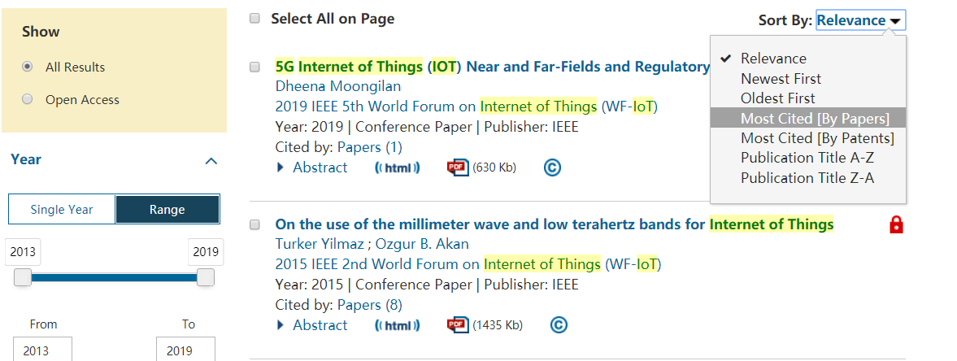

Efficient Search（高效检索）
高被引文献

Slide 20
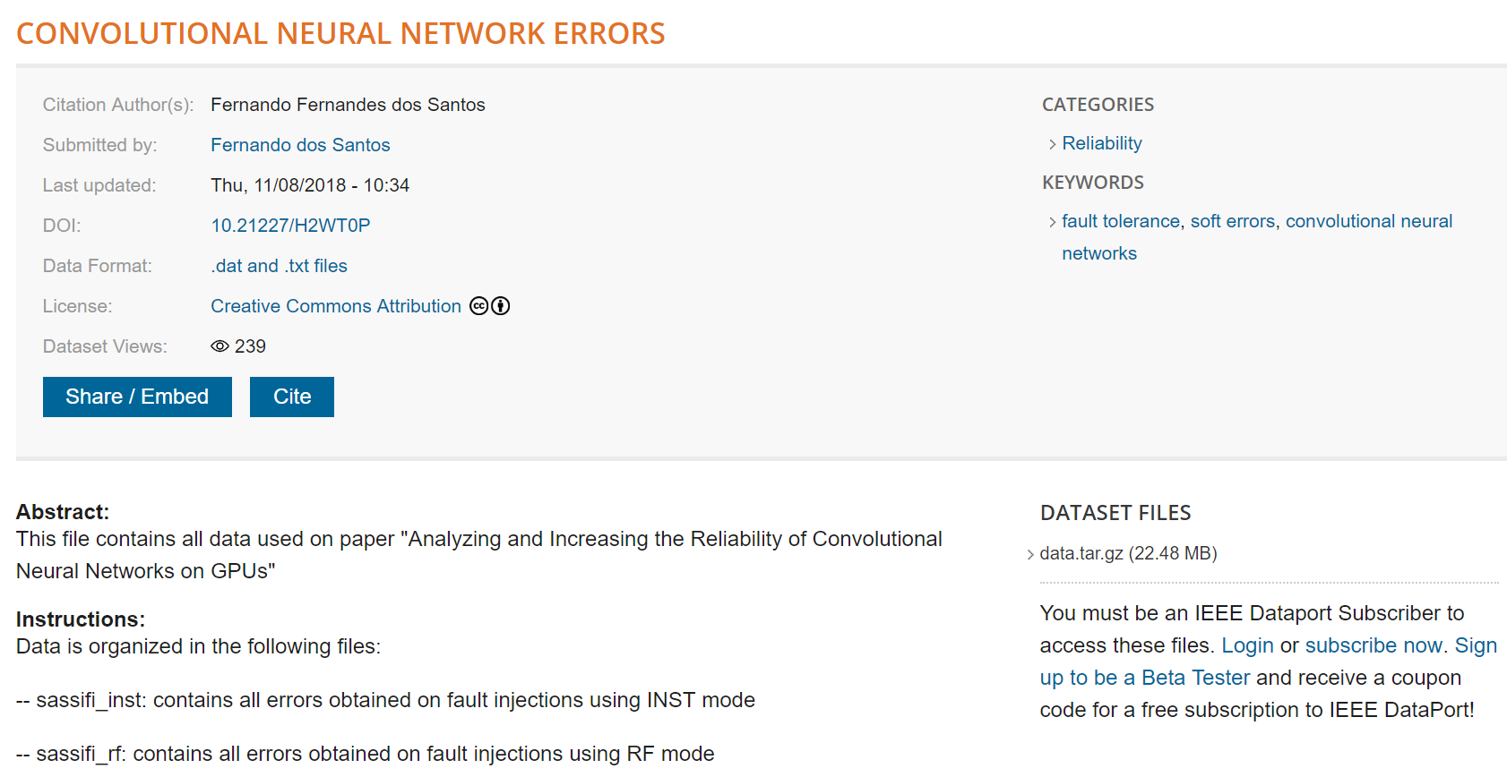
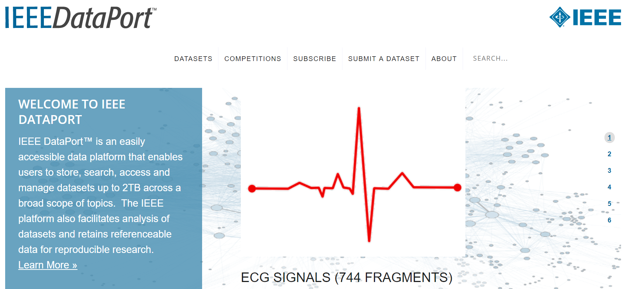
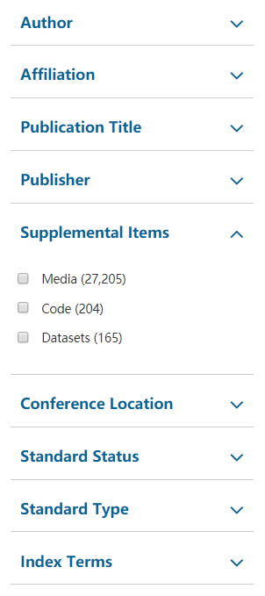
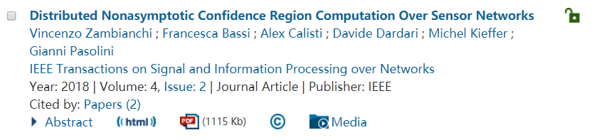
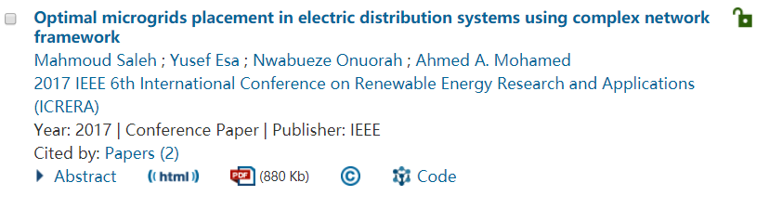
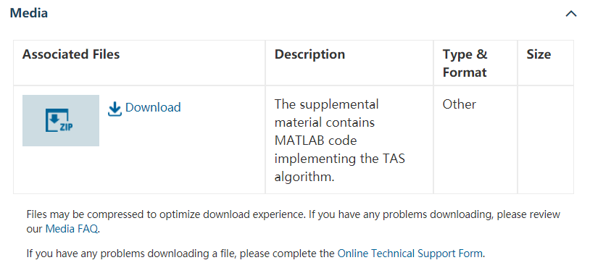
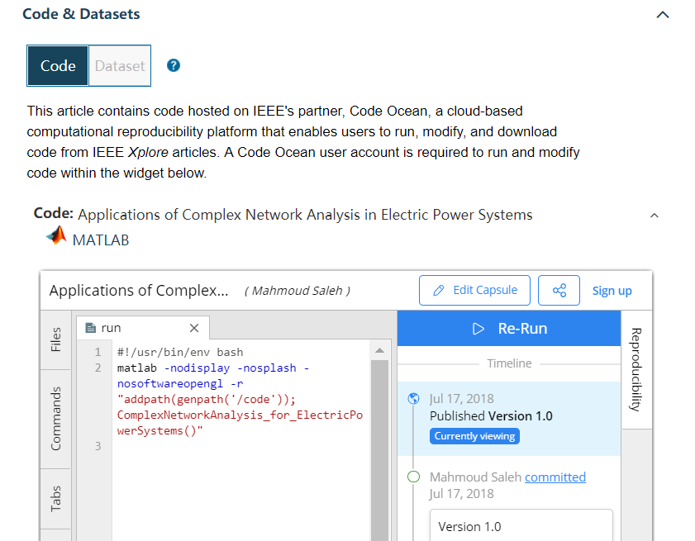

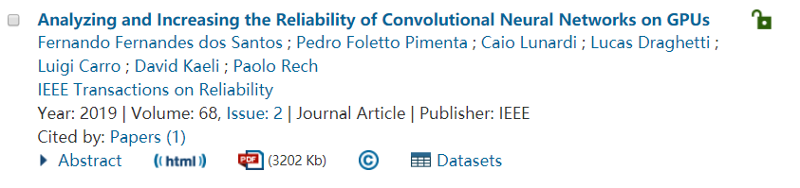
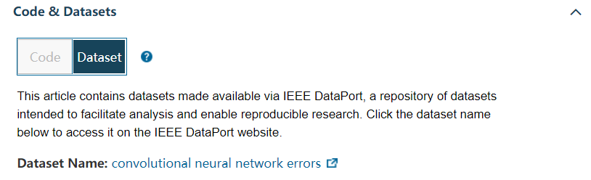
Supplemental Items（辅助资料）

Slide 21
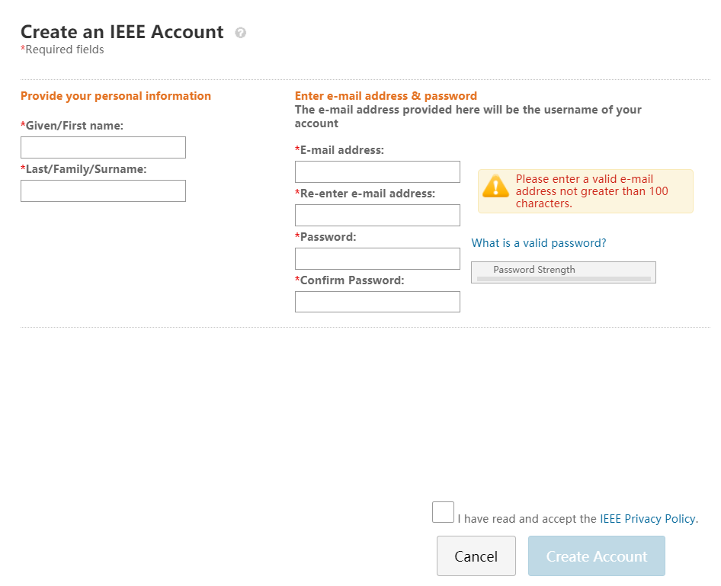

Create Account（创建账号）：定制个性化信息推送

Slide 22
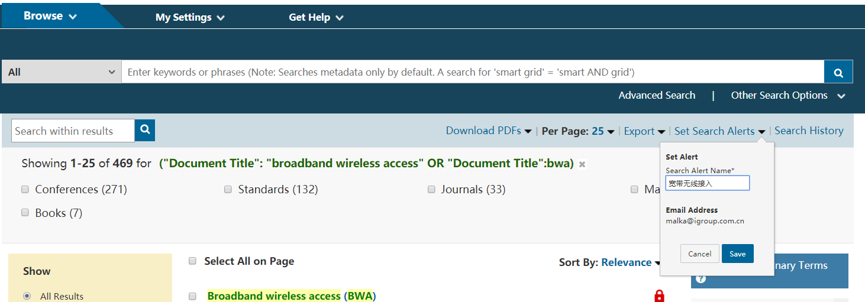
Set Search Alerts（检索提醒）：定制热点技术信息推送

Slide 23
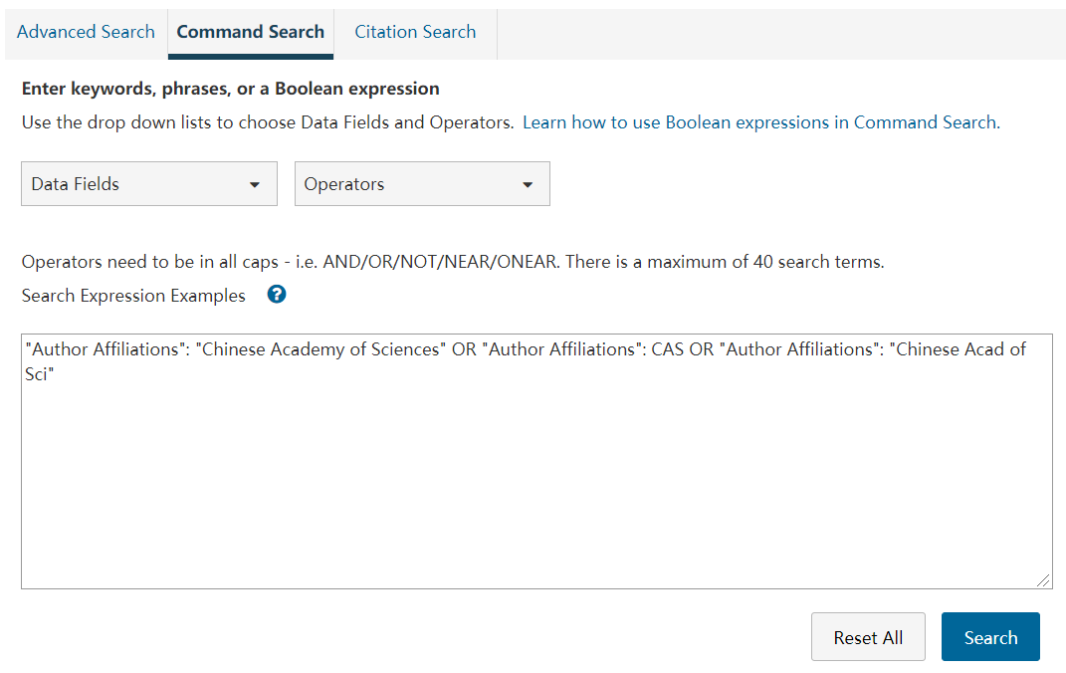
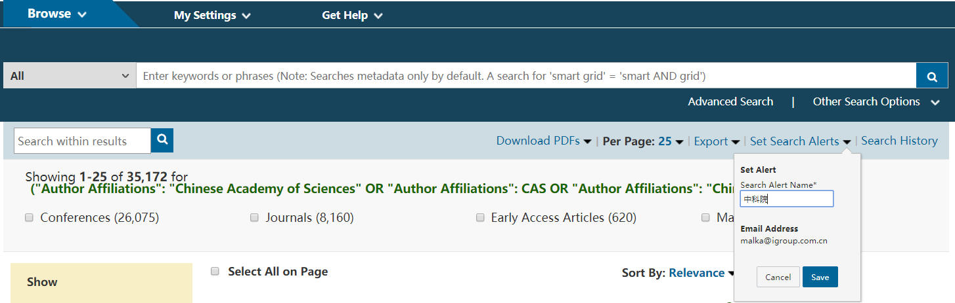
Set Search Alerts（检索提醒）：掌握机构研究动态

Slide 24



Set Search Alerts（检索提醒）：掌握权威研究人员最新进展

Slide 25

MyXplore App—随时随地掌握前沿资讯
iTunes App Store
Google Play
Android
腾讯应用宝
360手机助手
百度手机助手
小米应用商店
oppo/vivo应用商店

Slide 26
有的放矢
（IEEE期刊会议投稿）

Slide 27




IEEE 期刊杂志
190+
Journals, Transactions, Magazines
约80%被SCI收录
基本均被EI收录

Slide 28
IEEE quality makes an impact
Clarivate Analytics Journal Citation Reports® by Impact Factor
IEEE publishes:
20 of the top 20 journals in Electrical and Electronic Engineering
18 of the top 20 journals in Telecommunications
5 of the top 5 journals in Computer Science, Information Systems
4 of the top 5 journals in Computer Science, Hardware & Architecture
4 of the top 5 journals in Computer Science, Theory & Methods
3 of the top 5 journals in Computer Science, Artificial Intelligence
4 of the top 5 Automation & Control Systems
Clarivate Analytics Journal Citation Reports presents quantifiable statistical data that provides a systematic, objective way to evaluate the world’s leading journals.
Based on the 2018 study released June 2019
More info: www.ieee.org/publications/subscriptions/journal-citations.html

Slide 29
电气电子领域 高被引期刊
1. IEEE Transactions on Pattern Analysis and Machine Intelligence
2. IEEE Industrial Electronics Magazine
3. IEEE Transactions on Neural Networks and Learning Systems
4. IEEE Wireless Communications Magazine
5. Proceedings of the IEEE
6. IEEE Transactions on Smart Grid
7. IEEE Communications Magazine
8. IEEE Internet of Things Journal
9. IEEE Journal on Selected Areas in Communications
10. IEEE Transactions on Fuzzy Systems
11. IEEE Transactions on Medical Imaging
12. IEEE Transactions on Sustainable Energy
13. IEEE Signal Processing Magazine
14. IEEE Network (并列)
14. IEEE Transactions on Industrial Electronics (并列)
16. IEEE Transactions on Power Electronics
17. IEEE Transactions on Power Systems
18. IEEE Transactions on Image Processing
19. IEEE Journal of Selected Topics in Signal Processing
20. IEEE Transactions on Wireless Communications

Slide 30
通信领域 高被引期刊
1. IEEE Communications Surveys and Tutorials
2. IEEE Wireless Communications Magazine
3. IEEE Communications Magazine
4. IEEE Internet of Things Journal
5. IEEE Journal on Selected Areas in Communications
6. IEEE Network
7. IEEE Transactions on Wireless Communications
8. IEEE Vehicular Technology Magazine
9. IEEE Transactions on Communications
10. IEEE Transactions on Multimedia
11. IEEE Transactions on Vehicular Technology
12. IEEE Transactions on Emerging Topics in Computing
13. IEEE Transactions on Mobile Computing
14. IEEE Systems Journal
15. IEEE Transactions on Antennas and Propagation
16. IEEE Transactions on Broadcasting
17. Journal of Lightwave Technology
18. Internet Research
19. IEEE Access
20. Bell Labs Technical Journal (已被IEEE Xplore® Digital Library收录)

Slide 31
计算机领域 高被引期刊
Computer Science—Hardware & Architecture
#1 IEEE Transactions on Neural Networks and Learning Systems
#2 IEEE Wireless Communications Magazine
#3 IEEE Network
#4 IEEE Transactions on Dependable and Secure Computing
Computer Science—Information Systems
#1 IEEE Communications Surveys and Tutorials
#2 IEEE Wireless Communications Magazine
#3 IEEE Internet of Things Journal
#4 IEEE Network
#5 IEEE Transactions on Dependable and Secure Computing
Computer Science—Artificial Intelligence
#1 IEEE Transactions on Pattern Analysis and Machine Intelligence
#2 IEEE Transactions on Neural Networks and Learning Systems
#4 IEEE Transactions on Cybernetics

Slide 32
自动化控制领域 高被引期刊
Automation and Control Systems
#1 IEEE Transactions on Cybernetics
#2 IEEE Transactions on Industrial Electronics
#3 IEEE Transactions on Industrial Informatics
#4 IEEE Transactions on Systems, Man, and Cybernetics: Systems
交通领域 高被引期刊
Transportation Science & Technology
#2 IEEE Vehicular Technology Magazine
#4 IEEE Transactions on Intelligent Transportation Systems
#5 IEEE Transactions on Vehicular Technology
图像领域 高被引期刊
Imaging Science & Photographic Technology
#1 IEEE Geoscience and Remote Sensing Magazine
#3 IEEE Transactions on Medical Imaging
#5 IEEE Transactions on Geoscience and Remote Sensing

Slide 33
2019 IEEE 新刊
In 2019, IEEE will introduce seven new journals:
IEEE Networking Letters
IEEE Networking Letters publishes original research results derived from theoretical or experimental exploration of the area of communication/computer networking.
IEEE Journal on Miniaturization for Air and Space Systems
IEEE Journal on Miniaturization for Air and Space Systems addresses miniaturized sensor, instrumentation, control, and power systems for small air and space platforms and applications.
IEEE Transactions on Medical Robotics and Bionics
IEEE Transactions on Medical Robotics and Bionics publishes papers reporting research in the fields of robotics and of bionics applied to medicine.
IEEE Internet of Things Magazine
The Internet of Things Magazine publishes peer-reviewed articles on end-to-end IoT solutions.
IEEE Transactions on Biometrics, Behavior and Identity Science
The IEEE Transactions on Biometrics, Behavior, and Identity Science publishes original articles on all aspects of biometrics.
IEEE Journal of Selected Topics on Antennas and Propagation
IEEE Journal of Selected Topics on Antennas and Propagation publishes papers on original contributions within the general topics of electromagnetics, antennas, and wave propagation.
IEEE Journal on Electromagnetic Compatibility Practice and Applications
IEEE Journal on Electromagnetic Compatibility Practice and Applications is a forum for rapid publication of articles describing practice, lessons learned and applications of the disciplines electromagnetic compatibility and signal and power integrity.

Slide 34



学术期刊
Journals, Transactions, and Letters are the primary means for publishing technical papers concerning original work in IEEE fields of interest.
  The primary purpose of Journals, Transactions, and Letters is to disclose and provide a permanent archival record of original technical work that advances the state of the art or provides novel insights.
  Letters are for the publication of brief papers, usually three to four pages in length.

Slide 35



技术杂志
Magazines are characterized by regular and continuing issues with significant technical content in addition to general news and regular columns
  IEEE Communications Magazine
  IEEE Microwave Magazine
  IEEE Signal Processing Magazine
  IEEE Instrumentation & Measurement Magazine
  ......

Slide 36



寻找合适的期刊杂志、会议
http://publication-recommender.ieee.org/home

Slide 37












期刊杂志检索——了解更多信息

Slide 38


文章写作：作者中心与作者工具
https://ieeeauthorcenter.ieee.org/
Notes:
使用的模板
学术不端的限定
多媒体文档如何上传
参考文献自动检测

Slide 39







IEEE Collabratec AuthorLab
https://ieee-collabratec.ieee.org/app/community/18
Notes:
使用的模板
学术不端的限定
多媒体文档如何上传
参考文献自动检测

Slide 40




期刊杂志投稿

Slide 41
评审流程 Review Process
Submission
Rejection: topic
Journal Staff
Rejection: format
EIC
Accept
AE
Reviewers
Revise
EIC Makes Decision
Reject

Slide 42




论文检测（查重）
包括 IEEE 在内的国际主要出版机构和大部分 SCI 期刊都使用iThenticate/CrossCheck审查稿件。
  大部分SCI、SCI-E期刊使用该系统审查稿件
    86%的期刊编辑依靠iThenticate检测结果做出评判*
  高重复率可能被：
    ！拒稿
    ！认定抄袭
    ！更严重后果…
Notes:
前面在IEEE的投稿页面上，有一段说明：IEEE会对所有稿件使用CrossCheck系统进行抄袭审查。CrossCheck，或者大家可能听说过它的另一个名字iThenticate。其实国际主要出版机构和大部分SCI期刊都在使用iThenticate/CrossCheck审查稿件，以保证稿件的质量。并且有86%的期刊编辑会依靠iThenticate的重复率检测结果对稿件做出评判。高重复率稿件很可能被拒稿。

Slide 43
除开故意的情况，高重复率经常来自容易被忽略的误区，比如：
重复使用自己（或团队）已经发表论文中的内容，未做明示，即自我（或团队）抄袭。
不当引用，包括转引、漏引。或标注了引用，但是使用的是原文而不是自己的归纳总结。
母语非英语的作者，借鉴模仿英语句式结构，原句照搬。
综述论文、论文的材料和方法部分，容易出现高重复率。
。。。。。。
投稿前自查，能帮助科研人员
避免误区、提升论文质量
提升投稿效率，避免误会
有效指导学生
保护个人及合著者的声誉

Slide 44
IEEE会议
1,700+
Conferences
190+
Journals, Transactions, Magazines
基本均被EI收录

Slide 45
会议论文和期刊论文的区别
会议主要目的是通过演讲现场交流信息和交换想法
会议常常反映最新最前沿的研究，很多研究尚未到达正式期刊发表的程度。所以会议主要是快速传播科研信息，以从观众中获取宝贵的意见和反馈
会议常常会尽可能能覆盖较多的参与者，所以很多会议论文接受率较高
没有演讲此类口头交流信息的形式
期刊发表体现更严格的评审以及更高质量的成果
大部分期刊论文至少有3名以上评审人审稿，并有副主编定稿
期刊论文必须很好地反映该领域研究状态，因为评审人会仔细审核其引用文献
期刊论文接受率通常远低于会议论文

Slide 46










检索即将召开的会议——了解更多会议信息
Notes:
改infocom
了解往届文章的程度、方向、格式、周期等

Slide 47
IEEE 相关资源推介

Slide 48
欢迎参与IEEE学术交流！
Involvement in IEEE Societies, Sections and Chapters
Over 3,000 Student Branches in over 100 countries
Participation in IEEE Young Professional and Women in Engineering
1700+ conferences per year
IEEE Social media, such as Weibo, WeChat, etc.
Notes:
大量的社交平台，结识学术人脉，拓展学术交流圈，

Slide 49

IEEE 个人会员
IEEE Young Professional
http://cn.ieee.org/membership_join.html

Slide 50

IEEE免费技术讲座
Spectrum免费讲座，涉及最新科技：
http://spectrum.ieee.org/webinars
Communication Society免费讲座，通信领域热点技术：http://www.comsoc.org/webinars
Computer Society免费讲座，计算机领域热点技术：
http://www.computer.org/portal/web/webinars/Register-for-a-Webinar
Young Professional社团免费讲座，涉及职业发展，人文，科技等内容：
http://yp.ieee.org/members/webinars/past-webinars/
加入志愿者虚拟社团，获得行业最新咨询：
http://oc.ieee.org/

Slide 51
欢迎申请丰厚的IEEE奖学金！
IEEE Fellowship/Scholarship
  IEEE Charles LeGeyt Fortescue Fellowship
  IEEE Computational Intelligence Society Conference Travel Grants
  IEEE Computational Intelligence Society Summer Research Grant
  IEEE Computer Society Merwin Scholarship
  IEEE Dielectrics and Electrical Insulation Society Graduate Student Fellowship
  IEEE Electron Devices Society Graduate Student Fellowship
  IEEE James C. Klouda Memorial Scholarship Award
  ……
IEEE Competitions
  Presidents' Change the World Competition
  IEEE Computer Society Simulator Design Competition
  Student paper contest
  ……
https://www.ieee.org/membership/students/scholarships-grants-and-fellowships.html

Slide 52


Slide 53


Slide 54



欢迎关注！
微信公众号 ： IEEE QQ交流群： 微信公众号：
“IEEE Xplore微服务” 184712678 “学术猫”
下载 PPT 请登录微信公众号，首页回复中国传媒大学获取下载链接。
iGroup中国 IEEE数据库团队
iel@igroup.com.cn
Notes:
修改学校名称

